Slide 1
House Sales in the Xindian Dist., New Taipei City, Taiwan

Slide 2
Key Factors in Determine Selling Price
House prices depend on a few variables and factors
Data analysis was conducted on housing sales in the Xindian District, New Taipei City, Taiwan from 2012 and 2013
The analysis was done for just one district in New Taipei
This reduced the number of factors and variables
Factors examined are:
House age
Number of convenience stores
Distance to MRT Station (public transport)

Slide 3
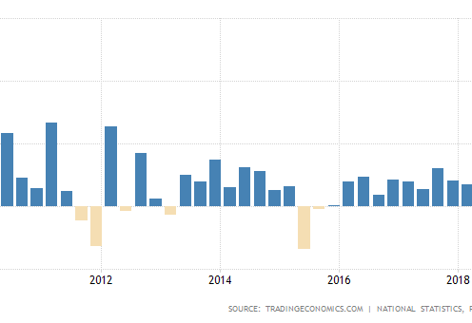
Data Acquisition
Taiwan GDP Growth from 2010 Q2 – 2018 Q1
Data was acquired from UCI repository
https://archive.ics.uci.edu/ml/datasets/Real+estate+valuation+data+set#
The data was developed by Prof. I-Cheng Yeh of Department of Civil Engineering, Tamkang University, Taiwan
Taiwan experienced a growth in GDP during this period after a downturn in the last 2 quarters of 2011
Surprisingly house sales went down during this period

Slide 4
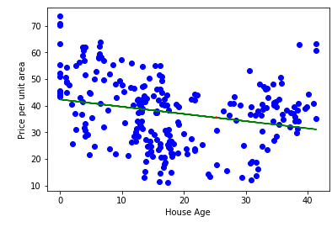
Is your old House Preventing a Higher Value?
This scatter plot shows the age of the house as minimal effect on the value
This may be due to perpetual renovations of older houses to keep up with the latest technology and aesthetics
Therefore, older houses can sell for a high price

Slide 5
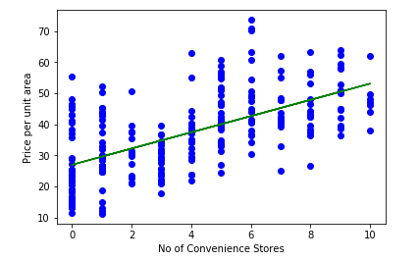
Impact of Convenience Stores
The number of convenience stores does not have an impact on house values
This may be due to the advent of e-commerce or ease of movement
Residents do not regard grocery shopping as a factor in determining where to buy a house or live

Slide 6
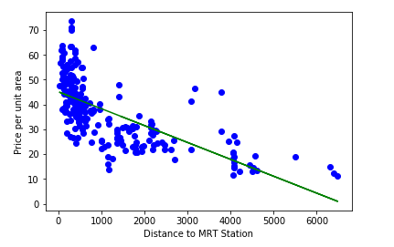
How Important is Transportation
The data analysis shows that distance to MRT stations impact housing values
The closer a house is to a MRT station, the higher the value of sold houses

Slide 7
Conclusion
Real estate investors should purchase houses closer to the MRT transportation
This analysis show “Upper-fixers” may ave success in this market as older houses aren’t drawbacks for customers

Slide 8
Next Steps
Examine neighboring districts to determine if the trends seen in Xindian District are similar
Determine how many cars are driven and sold in Xindian
This may help understand why is proximity closely correlates with house values
Look at data from a longer period of time

